Slide 1
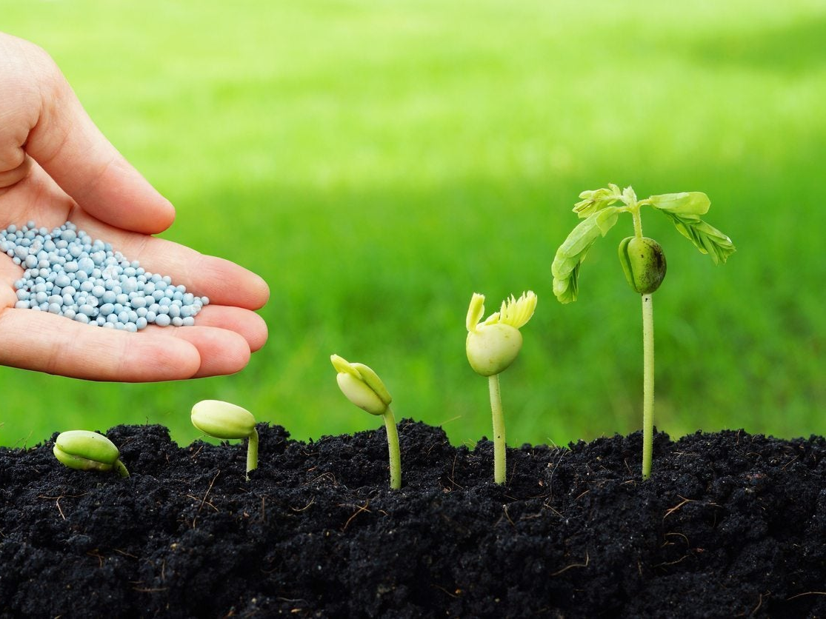
61st Vocations Awareness Week 2024
Seeds of hope and peace
Notes:
Leader: Today we are celebrating a special week in the Church. We are thinking about how God calls us in life, and remembering all the people that have followed God and served others as a priest, bishop, deacon, sister, brother, husband, wife, mother, father or single person. Can you think of some adults who have done these things?
[...pause…]
One day you will also listen to God and decide what you will do with your life. That is why we gather for National Vocations Awareness Week, and we remember that God calls each of us by name. Pope Francis asks us this week to think about how we can plant seeds of hope and peace in the world. So that is why our prayer focus includes some seeds, a trowel, a watering can and a potplant.
Image: weerapatkiatdumrong

Slide 2
The Light of Christ
Notes:
So we start by lighting our candle, the symbol of the light of Christ.
Image: Pexels

Slide 3
Sign of the Cross and
Opening Prayer
Response: Amen.
Notes:
Leader: Let us begin:
+ In the name of the Father, and of the Son, and of the Holy Spirit.
All: Amen.
Opening Prayer
Leader: Let us pray … (pause) …
God of love,
you call us each by name.
Invite us to follow you in our own special way.
Through Christ our Lord,
All: Amen.

Slide 4
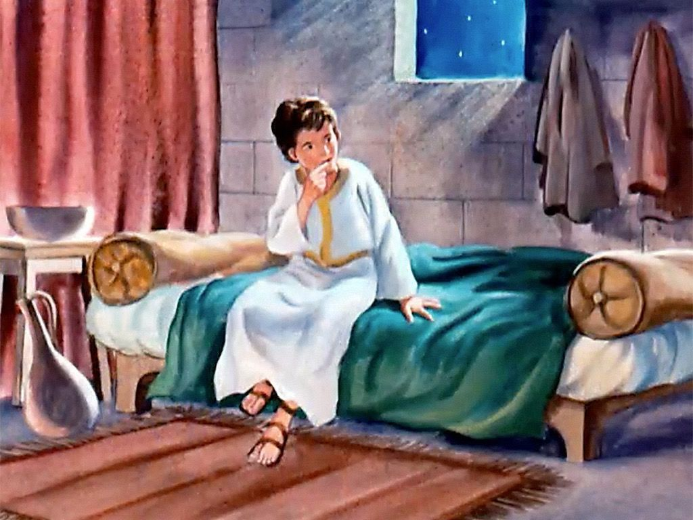
Reading: 1 Samuel 3:3-4,10-11
Notes:
Scripture Option 1
Leader: Now let us listen to a story of someone called by God, Samuel the Prophet.
Reader 3: A reading from the First Book of Samuel [1 Sam 3:3-4,10-11].
Samuel was lying down in the temple of the Lord, where the ark of God was.
Then the Lord called, ‘Samuel! Samuel!’ and he said, ‘Here I am! Speak, for your
servant is listening.’ Then the Lord said to Samuel, ‘See, I am about to do something in Israel.”
… (pause) …
Image: Free Bible Images

Slide 5
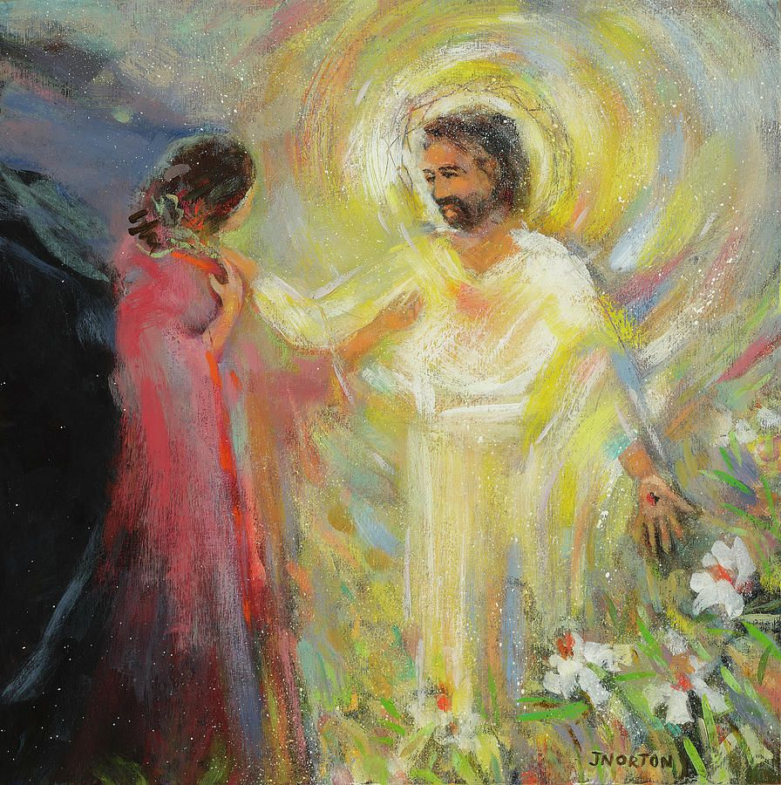
Reading: John 20:11,14,16-18
Notes:
Scripture Option 2
Leader: Now let us listen to a story of someone called by God, Mary Magdalene.
Reader 3: A reading from the Gospel of John [John 20:11,14,16-18].
Mary stood weeping outside the tomb. She turned round and saw Jesus standing
there, but she did not know that it was Jesus. Jesus said to her, ‘Mary!’ She turned and said to him in Hebrew, ‘Rabbouni!’ (which means Teacher). Jesus said to her, ‘Do not hold on to me, because I have not yet ascended to the Father. But go to my brothers and say to them, “I am ascending to my Father and your Father, to my God and your God.”’ Mary Magdalene went and announced to the disciples, ‘I have seen the Lord’.
… (pause) …
Image: Jen Norton

Slide 6
Reflection
Notes:
Leader: God calls each of us by name right now and for our future lives. But it is always a
good time to help God with the gardening!
[Assistant to hold up the seeds.]
Reader 4: We can discover the seeds God has planted in us. We each have gifts and
talents to share with others.
[Assistant to hold up the trowel.]
Reader 5: We can prepare the soil by learning and growing.
[Assistant to hold up the watering can.]
Reader 6: We can find what gives life to us and to others around us.
[Assistant to hold up the potplant.]
Reader 7: God already sees the plant that we are becoming, as we share God’s beauty with
the world. We can imagine what we might be in the future.

Slide 7
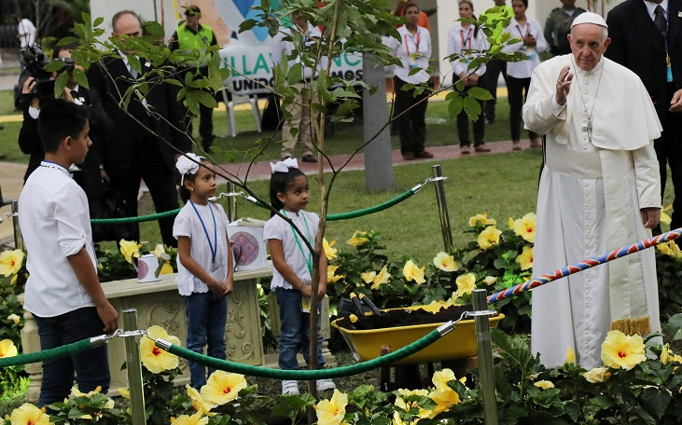
Prayers
Response: Lord, hear our prayer.
Notes:
Leader: So as we help with the gardening, we offer our prayers with confidence in God’s
love for us.
Reader 5: For all who are called by God.
May they have strength to keep going and growing.
Lord, hear us.
All: Lord, hear our prayer.
Reader 6: For those who care for families and children.
May their homes be places of love and giving thanks.
Lord, hear us.
All: Lord, hear our prayer.
Reader 7: For priests, deacons, sisters and brothers.
May they keep planting seeds of faith and hope.
Lord, hear us.
All: Lord, hear our prayer.
Reader 8: For those who serve others and our planet.
May they help God’s dream for goodness and peace come alive.
Lord, hear us.
All: Lord, hear our prayer.
Reader 9: For all of us with our special gifts and talents.
May we hear God calling us by name and have the courage to respond.
Lord, hear us.
All: Lord, hear our prayer.
Image: Reuters

Slide 8
Our Father who art in heaven,
hallowed be thy name.
Thy kingdom come.
Thy will be done
on earth, as it is in heaven.
Give us this day
our daily bread,
Notes:
Leader: Let us bring all our prayers to our loving God, in the words of Jesus:
All: Our Father...

Slide 9
and forgive us our trespasses,
as we forgive those who trespass against us,
and lead us not into temptation,
but deliver us from evil. Amen.

Slide 10
“Rise up!”
Let us wake from sleep,
let us open the doors,
so that each of us can discover his or her call
in the Church and in the world,
and help to plant seeds of hope and peace!
Let us love life,
and care with love for those around us,
in every place where we live. Amen.
Notes:
Leader: So let us conclude in the [adapted] words of Pope Francis for this Vocations
Week:
All: “Rise up!”
Let us wake from sleep,
let us open the doors,
so that each of us can discover his or her call
in the Church and in the world,
and help to plant seeds of hope and peace!
Let us love life,
and care with love for those around us,
in every place where we live.
Amen.

Slide 11
Blessing and Sign of the Cross
Response: Amen.
Response: Thanks be to God!
Notes:
Leader: May the God who calls bless us, + Father, Son, and Holy Spirit.
All: Amen.
Leader: Let us go with hope and peace for the world!
All: Thanks be to God!

Slide 13
61st Vocations Awareness Week 2024
Seeds of hope and peace

