Slide 1
61st Vocations Awareness Week 2024
Called to sow seeds of hope and to build peace
Notes:
Introduction
Leader: Today we celebrate National Vocations Awareness Week, and reflect on what we
are called to in life.
Reader 1: Hey, [name of Reader 2]!
Reader 2: What is it?
Reader 1: I’m calling you.
Reader 2: Well, that’s obvious. What are you calling me for?
Reader 1: I know you’re willing to give anything a try. Can you help me plant these seeds?
Reader 2: Sure, no worries.
Reader 1: And then there’s something bigger.
Reader 2: What do you mean?
Reader 1: Well, these seeds start off small, but they grow into a big plant. I can see you
growing, and sharing your gifts with the world too. This could be a vocation, which is about your whole life.
Reader 2: That sounds pretty big. But I want to make a difference, I just don’t know where
to start.
Reader 1: Start small. Here are the seeds to plant. If you want a life of meaning and
happiness, start here. Jesus wants the best for you, and he wants you to be free. He doesn’t impose, but always proposes.
Reader 2: OK, let’s start with the seeds.
Leader: This year our theme is ‘Called to sow seeds of hope and to build peace’. A
vocation is a calling, and we are all called by God to life and love. There are different ways to live this out over your whole life. For example, Pope Francis wants us to be grateful for mothers and fathers, advocates of justice and service, consecrated men and women, and priests. There are also other vocation pathways such as educators, singles and deacons. Each of us can find our own pathway and contribute to the bigger picture, fulfilling our lives and making the world a better place, full of hope and peace.
Image: weerapatkiatdumrong

Slide 2
Sign of the Cross and
Opening Prayer
Response: Amen.
Notes:
Call to Prayer
Leader: Let us begin:
+ In the name of the Father, and of the Son, and of the Holy Spirit.
All: Amen.
Opening Prayer
Leader: Let us pray … (pause) …
God of invitation,
you call us each by name.
Guide us forward into new paths of life.
Through Christ our Lord,
All: Amen.
Image: Pexels

Slide 3
Reading: 1 Samuel 3:3-4,10-11
Notes:
Leader: Now let us listen to two stories of people called by God, Samuel the Prophet and
Mary Magdalene.
Scripture
Reader 3: A reading from the First Book of Samuel [1 Sam 3:3-4,10-11].
Samuel was lying down in the temple of the Lord, where the ark of God was.
Then the Lord called, ‘Samuel! Samuel!’ and he said, ‘Here I am! Speak, for your
servant is listening.’ Then the Lord said to Samuel, ‘See, I am about to do something in Israel.”
… (pause) …
Image: WorldChallenge.org

Slide 4
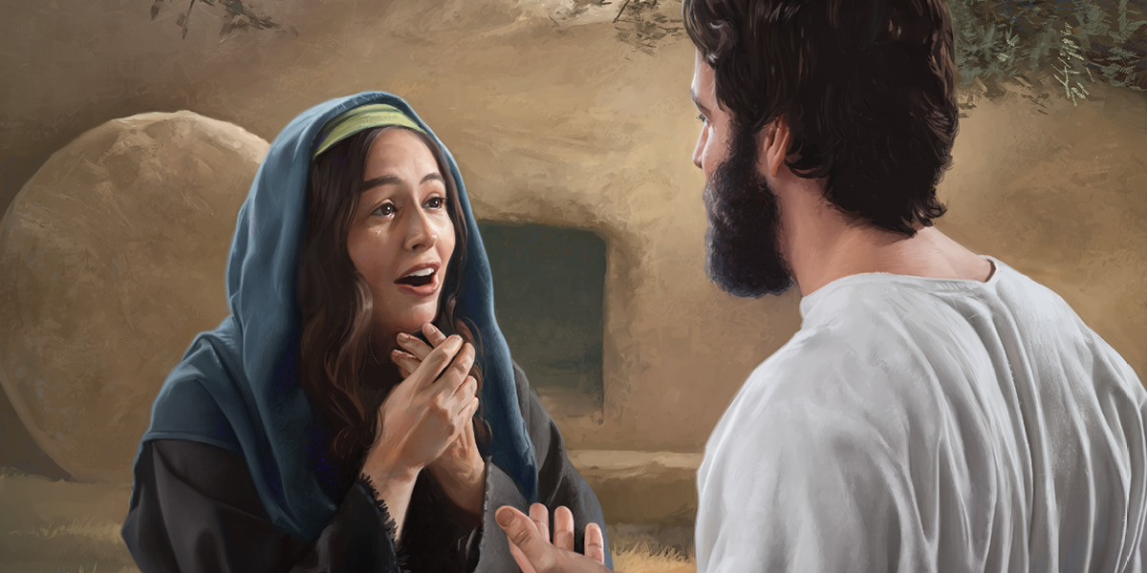
Reading: John 20:11,14,16-18
Notes:
Reader 4: A reading from the Gospel of John [John 20:11,14,16-18].
Mary stood weeping outside the tomb. She turned round and saw Jesus standing
there, but she did not know that it was Jesus. Jesus said to her, ‘Mary!’ She turned and said to him in Hebrew, ‘Rabbouni!’ (which means Teacher). Jesus said to her, ‘Do not hold on to me, because I have not yet ascended to the Father. But go to my brothers and say to them, “I am ascending to my Father and your Father, to my God and your God.”’ Mary Magdalene went and announced to the disciples, ‘I have seen the Lord’.
… (pause) …
Image: dongcatminh.org

Slide 5
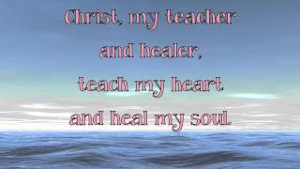
Reflection
How am I called?
Small things?
Big pathways?
Notes:
Leader: God calls each of us by name to sow seeds of hope and peace, right now and in
our future callings. We might hear that call through other people, through a deep inner feeling, through prayer, through the news or the world around us. As we listen to this song, let us reflect on the questions on the screen:
How am I called?
Small things?
Big pathways?

Slide 6
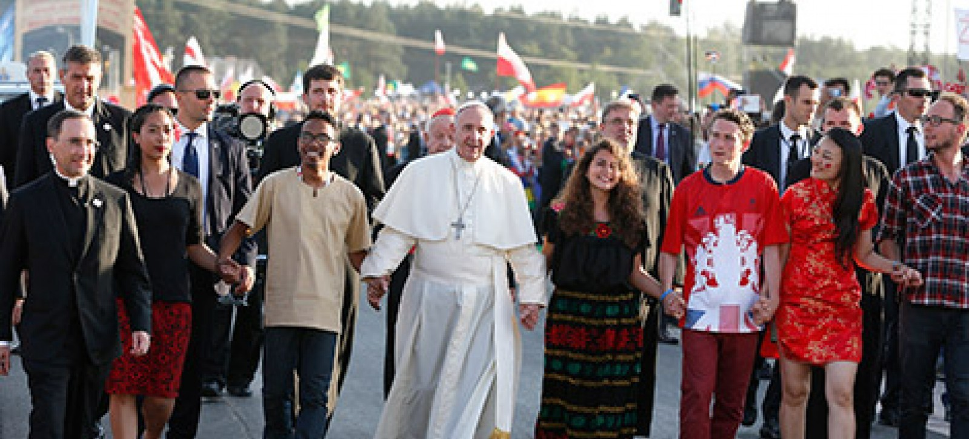
Prayers
Response: Lord, hear our prayer.
Notes:
Leader: God leads us to freedom as we are called to build the Kingdom of peace, hope
and joy. Let us offer our prayers with confidence in God’s love.
Reader 5: For all who have given their lives to God’s call.
May they have strength and spirit to keep going and growing.
Lord, hear us.
All: Lord, hear our prayer.
Reader 6: For those who have dedicated their lives to families and children.
May their households be built on love, giving and gratitude.
Lord, hear us.
All: Lord, hear our prayer.
Reader 7: For those called by the Church as priests, deacons and consecrated people.
May they keep nurturing seeds of faith and hope.
Lord, hear us.
All: Lord, hear our prayer.
Reader 8: For those who have committed to causes of justice, service and peace.
May they believe in the future and continue to be inspired.
Lord, hear us.
All: Lord, hear our prayer.
Reader 9: For all of us, who search for purpose and happiness.
May we hear God calling us by name and have the courage to respond.
Lord, hear us.
All: Lord, hear our prayer.
Image: US Conference of Catholic Bishops

Slide 7
Our Father who art in heaven,
hallowed be thy name.
Thy kingdom come.
Thy will be done
on earth, as it is in heaven.
Give us this day
our daily bread,
Notes:
Leader: Let us bring all our prayers to our loving God, in the words of Jesus:
All: Our Father...

Slide 8
and forgive us our trespasses,
as we forgive those who trespass against us,
and lead us not into temptation,
but deliver us from evil. Amen.

Slide 9
“Rise up!”
Let us awaken from sleep,
let us leave indifference behind,
let us open the doors of the prison in which we so often enclose ourselves,
so that each of us can discover his or her proper vocation
in the Church and in the world,
and become a pilgrim of hope and a builder of peace!
Notes:
Leader: So let us conclude in the words of Pope Francis for this Vocations Week:
All: “Rise up!”
Let us awaken from sleep,
let us leave indifference behind,
let us open the doors of the prison in which we so often enclose ourselves,
so that each of us can discover his or her proper vocation
in the Church and in the world,
and become a pilgrim of hope and a builder of peace!
Let us be passionate about life,
and commit ourselves to caring lovingly for those around us,
in every place where we live.
Let me say it again: “Have the courage to commit!”
Amen.

Slide 10
Let us be passionate about life,
and commit ourselves to caring lovingly for those around us,
in every place where we live.
Let me say it again: “Have the courage to commit!”
Amen.

Slide 11
Blessing and
Sign of the Cross
Response: Amen.
Response: Thanks be to God!
Notes:
Leader: May the God who calls bless us, + Father, Son, and Holy Spirit.
All: Amen.
Leader: Let us go forth to sow seeds of hope and peace in the world!
All: Thanks be to God!

Slide 12
61st Vocations Awareness Week 2024
Called to sow seeds of hope and to build peace

